Slide 1

Object Oriented Programming (OOP)
Author: Petru Covaliov
Date: 25-02-2016

Slide 2
What we will study ?
Introduction to OOP
Principles of OOP
Constructors and Instantiation
Overridden and Overloaded Methods
Class Access modifiers
Class Modifiers (Nonaccess)
Abstract Classes
Coupling
Cohesion

Slide 3
Introduction to OOP
Object oriented programming (OOP) is a programming style that represents the concept of objects that have data fields (attributes that describe the object) and associated procedures known as methods.
An object can be considered a "thing" that can perform a set of activities. Software objects are often used to model the real-world objects that you find in everyday life. Objects are used to interact with one another to design applications and computer programs.
A class is a blueprint or prototype from which objects are created.
Notes:
Class is a template that descries an object, its behavior, state and type.
Object is created when word new is encountered.
Object has variables and methods.

Slide 4
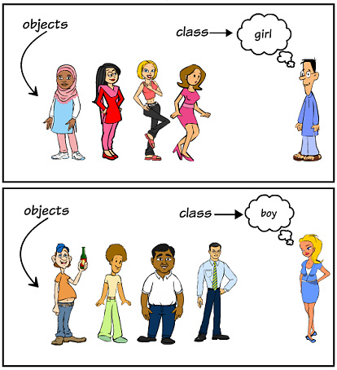

Slide 5
Principles of OOP
Encapsulation
Inheritance
Polymorphism

Slide 6
Encapsulation
In object-oriented programming, objects interact with each other by messages. The only thing that an object knows about another object is the object's interface. Each object's data and logic is hidden from other objects. In other words, the interface encapsulates the object's code and data
Encapsulation allow the developer to separate an object's implementation from its interface. This separation creates a "black-box" effect where the client is isolated from implementation changes. As long as the interface remains the same, any changes to the internal implementation is transparent to the client

Slide 7
The main benefit of encapsulation is the ability to modify our implemented code without breaking the code of others who use our code. With this feature encapsulation gives maintainability, flexibility and extensibility
Encapsulated code has two features:
Instance variables are kept protected (usually with the private modifier)
Getter and setter methods provide access to instance variables

Slide 8
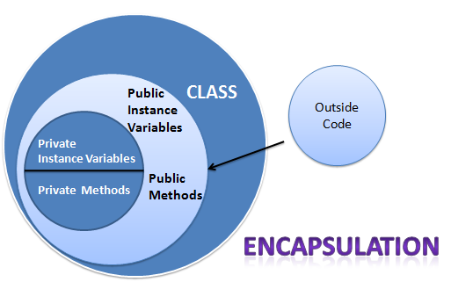

Slide 9
Inheritance
Inheritance allows a class to be a subclass of a superclass, and thereby inherit public and protected variables and methods of the superclass
All classes (except class Object), are subclasses of type Object, and therefore they inherit Object’s methods
The main advantage is the reuse of code in the subclass, modifying or adding something new
Example: class Man and class Woman have all the attributes of class Human, but each of them has specific attributes also

Slide 10
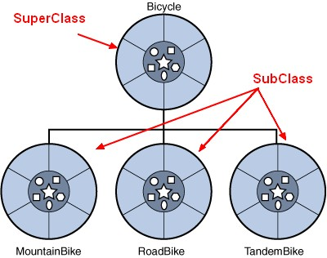

Slide 11
Polymorphism
Polymorphism is the ability of an object to take on many forms
The most common use of polymorphism in OOP occurs when a parent class reference is used to refer to a child class object
Polymorphism allows the same method to be implemented in different classes diferently
The main advantage is that less code is written and the application become clearer
The reference variable’s type (not the object’s type), determines which methods can be called
Polymorphic method invocations apply only to overridden instance methods

Slide 12
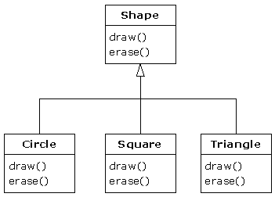

Slide 13
Constructors and Instantiation
A constructor is always invoked when a new object is created
To make a new object, you have to invoke the constructor of the object’s actual class type and also the constructor of each of its superclasses
Every class, even an abstract class, has at least one constructor
Constructors must have the same name as the class
Constructors don’t have a return type
The compiler will create a default constructor if you don’t create any constructors in your class
Abstract classes have constructors that are called when a concrete subclass is instantiated
Interfaces do not have constructors

Slide 14
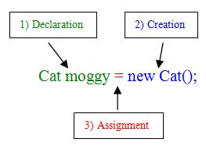

Slide 15
Overridden and Overloaded Methods
A method from a class is considered to be overridden by a subclass’ method when they have the same signature
Object type (not the reference variable’s type), determines which overridden method is used at runtime
Overriding method must have the same argument list, same return type, must not have a more restrictive access modifier, may have a less restrictive access modifier, must not throw new or broader checked exceptions, may throw fewer or narrower checked exceptions, or any unchecked exception
Abstract methods must be overridden by the first concrete (non-abstract) subclass
final methods cannot be overridden

Slide 16
Only inherited methods may be overridden and private methods are not inherited
Overloading means reusing a method name, but with different arguments
Overloaded methods must have different argument lists; may have different return types, if argument lists are also different; may have different access modifier; may throw different exceptions

Slide 17
Class Access Modifiers
There are three access modifiers: public, protected and private
There are four access levels: public, protected, default and private
Classes can have only public or default access
A class with default access can be seen only by classes within the same package
A class with public access can be seen by all classes from all packages

Slide 18
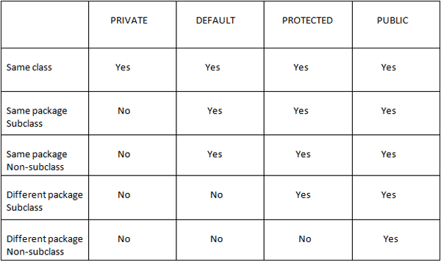

Slide 19
Class Modifiers (Nonaccess)
Classes can be modified with final, abstract or strictfp
A class cannot be both final and abstract
A final class cannot be subclassed

Slide 20
Abstract Classes
In an abstract class may be declared and initialized static and instance variables
It is possible to declare constructors, write static and instance methods
In an abstract class may not be declared abstract methods
Objects of abstract class type can’t be created
An abstract class can’t be instantiated
An abstract class is designed to be extended
If a class contains at least one abstract method, then this class must be declared abstract
An abstract class can have both abstract and nonabstract methods
The first concrete class to extend an abstract class must implement all of its abstract methods

Slide 21
Coupling and Cohesion
Coupling refers to the degree to which one class knows about or uses members of another class
Loose coupling is the desirable state of having classes that are well encapsulated, minimize references to each other and limit the breadth of API usage
Tight coupling is the undesirable state of having classes that break the rules of loose coupling
Cohesion refers to the degree in which a class has a single, well-defined role or responsibility
High cohesion is the desirable state of a class whose members support a single, well-focused role or responsibility
Low cohesion is the undesirable state of a class whose members support multiple, unfocused roles or responsibilities

